Slide 1

CECS 443 Final Exam
By: Yuvika Nibber
ID: 012780675
Professor: Jamal Madni

Slide 2
Requirements Table
Requirement | Acceptance Criteria | Module | Effort Score | Effort Equation | Priority
Website should be interactive and allow members to login with their CSULB credentials | Allows people to move around the website, login and save their profile. | Frontend | 0.008565258 | (49.7^3) / ((30^3) *((480/100))^4) | H
Filters out resumes according to best match | The database stores resumes and filters it according to the best matching candidate. | Middleware | 0.142916667 | (50.4^3) / ((30^3) *((240/100))^4) | M
It allows people to input data like their resume, essay question and any additional information or documentation. | Ensures that user can input their information. | Frontend | 0.054283753 | (36.5^3) / ((30^3) *((240/100))^4) | H
Stores, pulls and displays all information into the database | Make sure the data inputted by the user is saved, pulled and displayed aesthetically and the user can retrieve it later. | Backend | 0.002933787 | (13.8^3) / ((30^3) *((240/100))^4) | H
Website displays the current Covid dashboard with updates regarding re-opening of campus and other important safety measures | Ensures safety of all members and keep them updated with the current Covid-19 situations. | Frontend | 0.022464563 | (27.2^3) / ((30^3) *((240/100))^4) | H

Slide 3
Requirements Table (cont.)
Requirement | Acceptance Criteria | Module | Effort Score | Effort Equation | Priority
Create a detailed list of people with their name, student ID, degree, major, gender, age, ethnicity that pulls from the database | SQL database that has tables with the candidate's information and sort it according to the best match | Backend | 0.00019145 | (14^3) / ((30^3) *((480/100))^4) | H
It should organize and put student data into graphs based on their GPA, year, resume, essay question, additional documents | Graphs are created depicting accurate data of the students. | Middleware | 0.0000199773 | (14.2^3) / ((30^3) *((480/100))^4) | L
Setup email service linked to the user’s CSULB account | Make sure there is a way for communication between the student and professor using their CSULB account. | Middleware | 0.003255208 | (36^3) / ((30^3) *((480/100))^4) | H
Display what positions are available | Make sure the available positions are up to date and the expired positions are archived. | Frontend | 0.125786103 | (48.3^3) / ((30^3) *((240/100))^4) | L
Allow users to apply and withdraw application | Database that stores applications and allows user to apply on the website and withdraw if they no longer want to be considered for the position. | Frontend | 0.007197635 | (46.9^3) / ((30^3) *((480/100))^4) | M

Slide 4
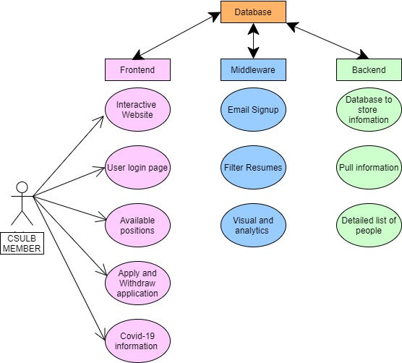
Architecture Diagram

Slide 5
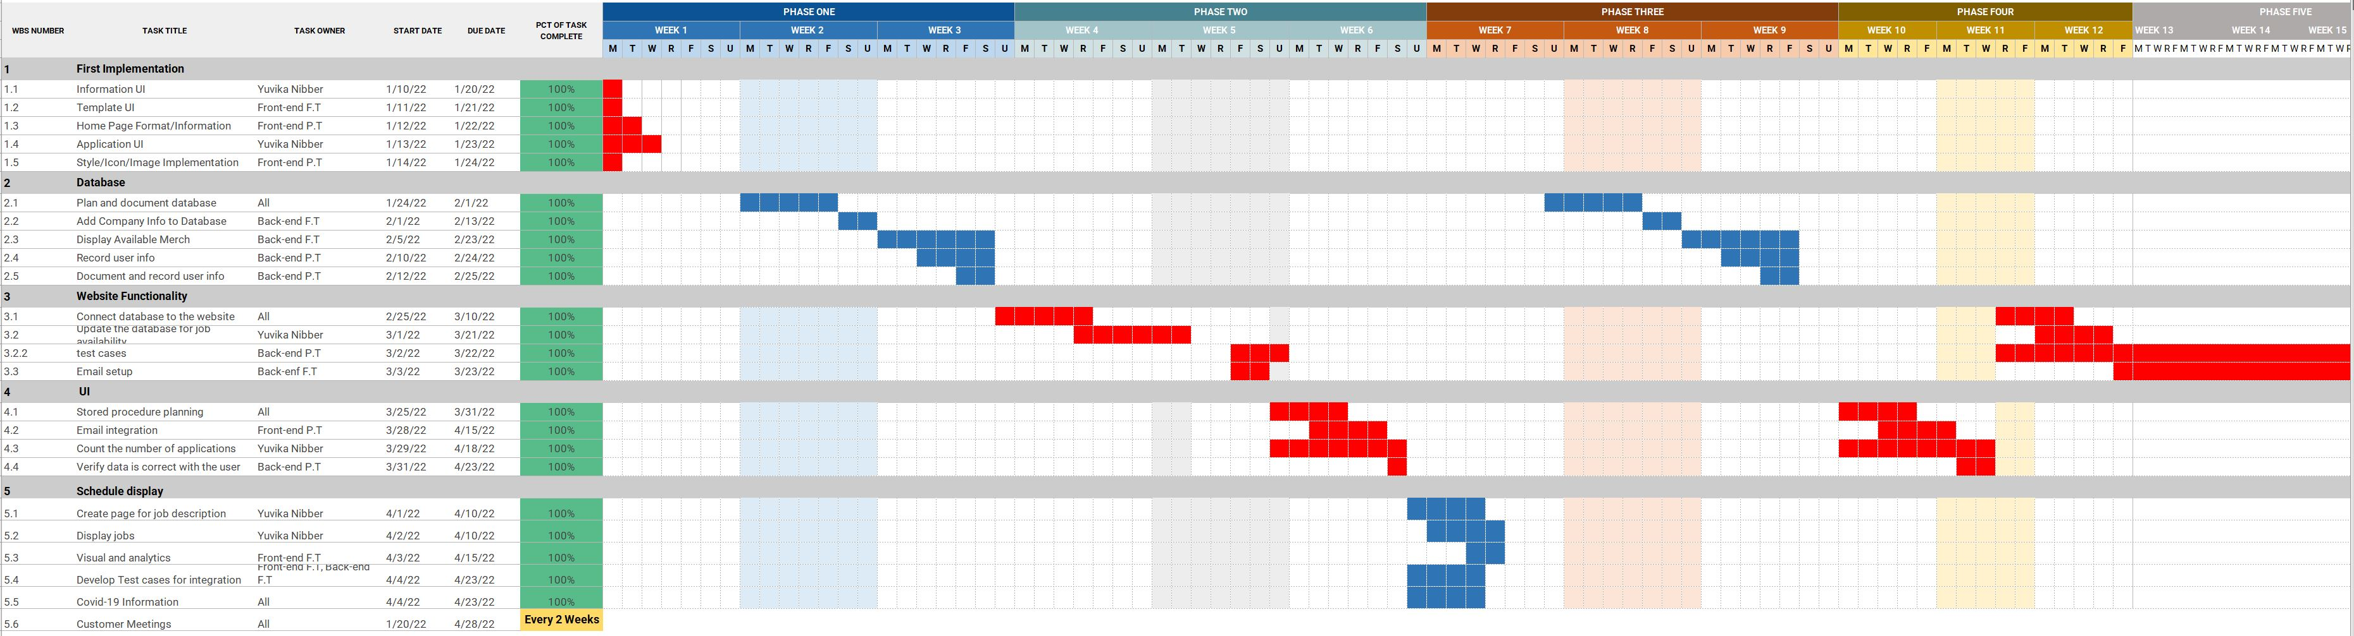
Gantt Chart

Slide 6
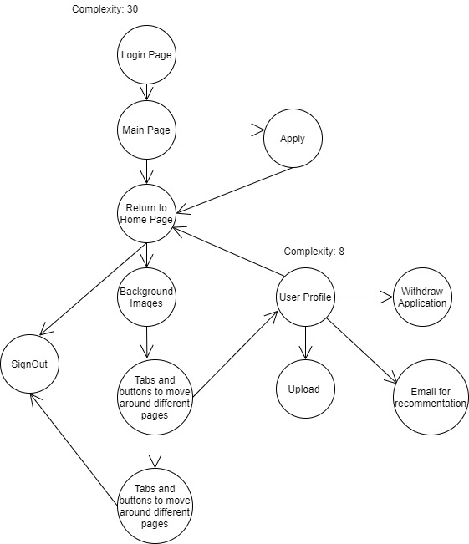
Graph Flow Notation and Cyclomatic Complexities

Slide 7
Software Management and Testing Strategy

Slide 8
Software Management and Testing Strategy
Top 3 Software Progress Metrics:
Risk Analysis, verification and validation
Test Planning and quality assurance processes, Error Density
Test Report and Evaluation, CPI
Top 3 Specific Processes:
Black box testing
Early testing and risk management
Diversity in testing environments/ better communication

